Slide 1

AE 482
Agric Engineering Design Project
Unit 2: Prime Movers
Mr. Joseph AVEYIRE
aveyire@yahoo.com // 024 4652593

Slide 2
Introduction
Unit two covers the selection of prime movers. It
Discusses about types of prime movers
Analysis the relationships between prime movers and mechanical loads

Slide 3
UNIT 2: Learning Objectives
Classify prime movers
Explain the principles and operation of IC- engine
Explain the principles and operation of electric motors
Explains and demonstrates power ratings of electrical motors
Explain the characteristic curves of both prime movers and mechanical loads
Choose suitable prime movers for some mechanical loads

Slide 4
UNIT 2: Prime mover
Definition Prime mover
It is a source of power or a driving unit
Besides animal and human power sources, there are two main mechanical types:
combustion engine and
Electric motor.

Slide 5
UNIT 2: Combustion Engine
Classification
Criterion : Location of firing
External combustion
Internal combustion

Slide 6
UNIT 2: Type of IC-engines and E-motors
Combustion engine |  |  | Electric motor
Internal Combustion (combustion gas is the same working medium) |  | External combustion (combustion gas not the same working medium
Intermittent Firing | Continuous Firing
Otto motor Diesel motor Wankel motor | Gas turbines Axial piston motor | Stirling’s motor Steam engine | E-motor with battery E-motor with fuel cell
Hybrid-drives

Slide 7
UNIT 2: Classification of Internal Combustion Engine
Classification:
Mode of operation and
Fuel used (Otto and Diesel engine)
Mode of Operation
Single firing (Rotary engine and Piston engine)
Four-Stroke Engine
Two-Stroke Engine
Continuous firing (gas turbine)

Slide 8
UNIT 2: Fuel Used (thermodynamic Cycle Operation)
Constant Volume Heat Addition Cycle (Ideal Otto engine):
Mixture of air and fuel is ignited in the combustion chamber.
Resulting heat causes an increase in the pressure of the already pre-compressed combustible mixture.
Expansion work or energy is extracted only during the expansion process.
Fresh homogeneous mixture replaces the burnt gases

Slide 9
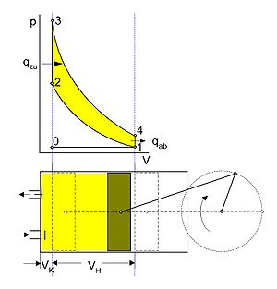
UNIT 2: Fuel Used (thermodynamic Cycle Operation)
Constant Volume Heat Addition Cycle (Ideal Otto engine):
1 - 2 : isentropic compression
2 - 3 : isochoric heat addition (hence constant volume process)
3 - 4 : isentropic expansion
4 - 1 : isochoric heat removal

Slide 10
UNIT 2: Fuel Used (thermodynamic Cycle Operation)
Constant Pressure Heat Addition Cycle (Ideal diesel engine):
Pure air is compressed and fuel is sprayed under high pressure.
Very high compression ratio
Combustible mixture is not homogeneous,
The compressed mixture experiences self-ignition,
High air ratio i.e. low fuel mixture. Results in less loss which would have been due to insufficient oxygen

Slide 11
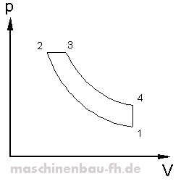
UNIT 2: Fuel Used (thermodynamic Cycle Operation)
Constant Pressure Heat Addition Cycle (Ideal diesel engine):
1 – 2: isentropic compression
2 – 3: isobaric heat addition (hence constant pressure process)
3 – 4: isentropic expansion
4 – 1: isochoric heat addition

Slide 12
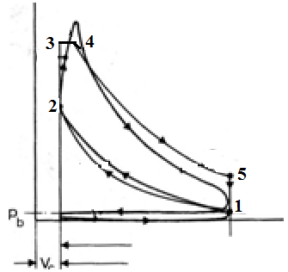

UNIT 2: Fuel Used (thermodynamic Cycle Operation)
Mixed Constant Volume & Constant Pressure Heat Addition Cycle (Real Otto & diesel engines):
1 – 2: isentropic compression.
2 – 3: isochoric compression.
3 – 4: isobaric combustion
4 – 5: isentropic expansion
5 – 1: isochoric exhaustion

Slide 13
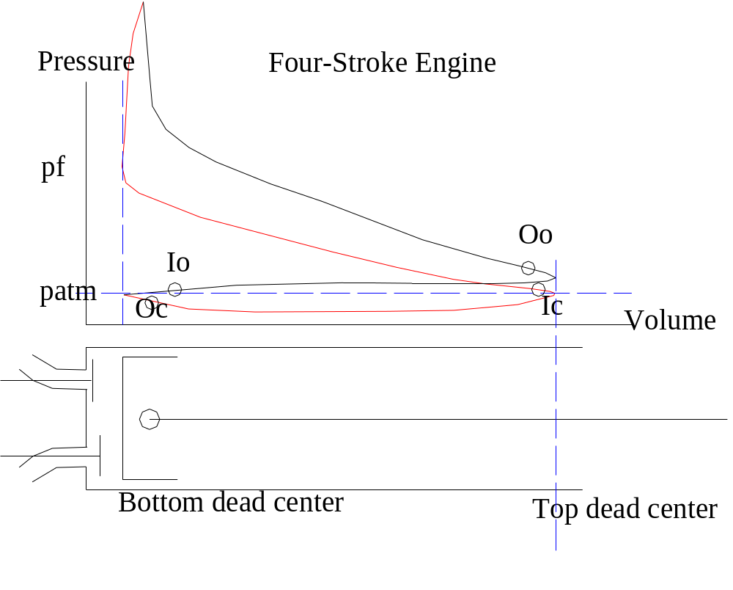
UNIT 2: Mode of Operation (Number of Strokes)
Four-Stroke Engine:
Suction, compression, expansion and exhaust.
Charge changes and work are accomplished by changes in the volume of the combustion chamber.
Control of exhausting gases and intake of fresh combustible mixtures are achieved by the valves.

Slide 14
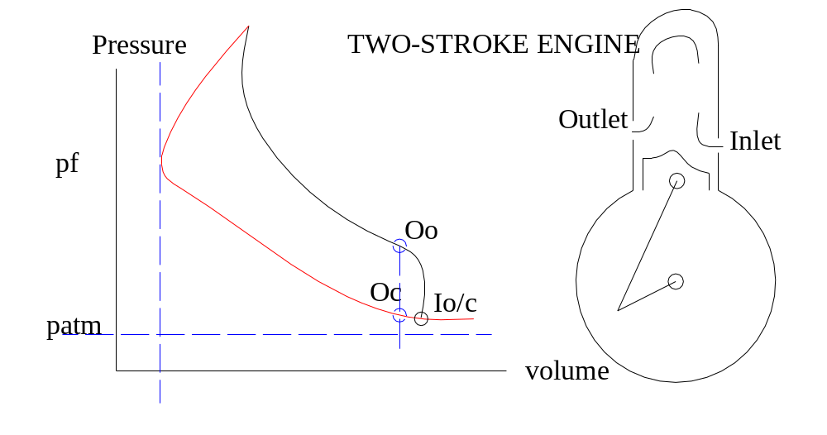
UNIT 2: Mode of Operation (Number of Strokes)
Two-Stroke Engine:
Waste gases are blown out by incoming fresh combustible mixture.
Expelling of exhaust gases and intake of fresh mixture is controlled by the piston
Lower section of piston and housing acts as compression room

Slide 15
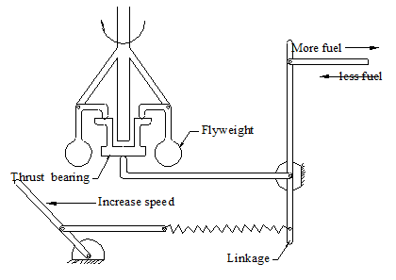
UNIT 2: Control of Engine Speed
It is desirable to perform agricultural operations at nearly constant speed.
Governors control speed of engines by regulating fuel delivery to the engine
Figure 2-1: Flyweight governor

Slide 16
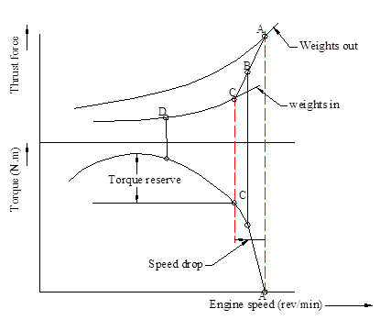
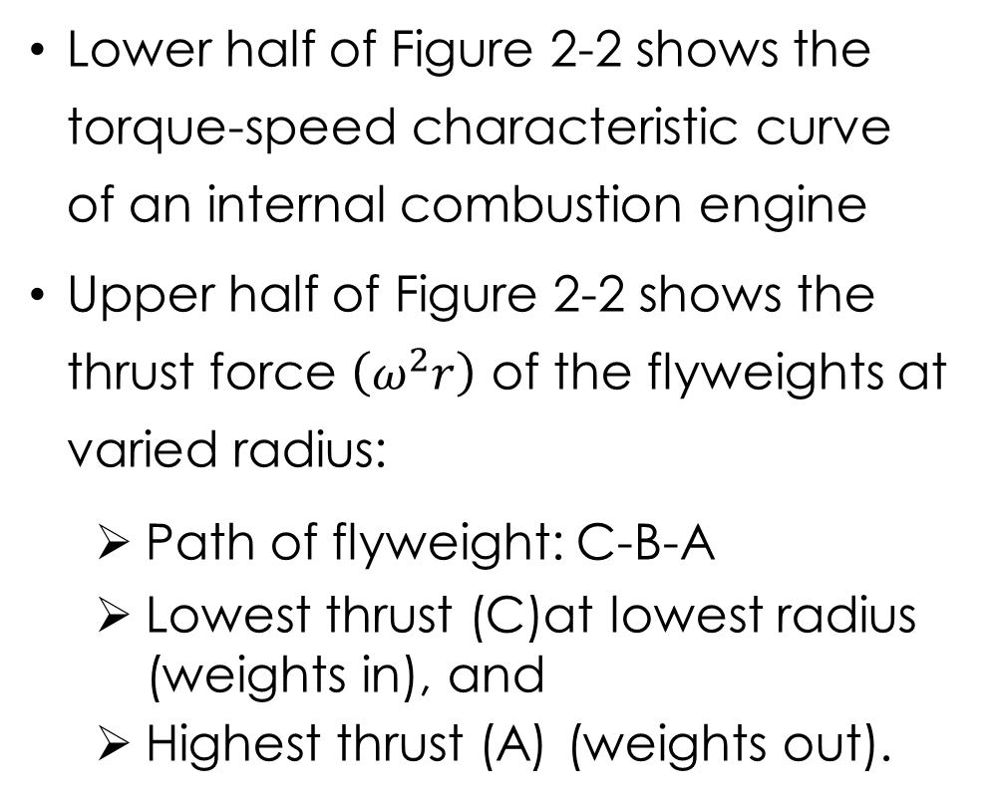
UNIT 2: Flyweight Governor
Lower half of Figure 2-2 shows the torque-speed characteristic curve of an internal combustion engine
Upper half of Figure 2-2 shows the thrust force $\left(ω^{2}r\right)$ of the flyweights at varied radius:
Path of flyweight: C-B-A
Lowest thrust (C)at lowest radius (weights in), and
Highest thrust (A) (weights out).
Figure 2-2: Characteristic curves of flyweight governor and internal combustion engine

Slide 17
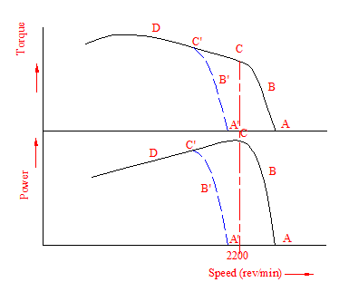
UNIT 2: Control of power and torque by flyweight Governor
Power rises linearly with torque increase in the governor-controlled range (A-C)
In load-controlled range, power falls nearly direct proportion (C-D)
Torque reserve (from D to stop of engine)
Figure 2-3: Characteristic curves of torque and power against speed of IC engine

Slide 18
UNIT 2: Electrical Motor
Two Working Principles:
Principle of electromagnetic induction (Faraday, 1831):
“a conductor moving through a magnetic field, experiences an induced current in it (electrical generator).
Principle electromagnetic reaction (Ampere, 1820):
If a current is passed through a conductor located in a magnetic field, the field exerts a mechanical force on it (electrical motor).

Slide 19
UNIT 2: Name-Plate of E-Motor
  Vital Information on the Name-plate of E-Motor:
  Voltage: Proper operating voltage value.
  Current: Full-load current drawn at specified voltage.
  Speed: Rotor speed when the motor is running full-load point on the torque-speed curve.
  Duty: Rated for continuous or intermittent,
  Temperature: Allowable temperature rise between hottest part above a 40ºC ambient temperature while operating at full load.
  Motor Service Factor (SF): Percentage of overloading that motor can handle for short periods when operating normally within the correct voltage tolerances. For farm duty motors SF=1.35 or more.
  Power output: Motors are specified in kW (kilowatt)

Slide 20
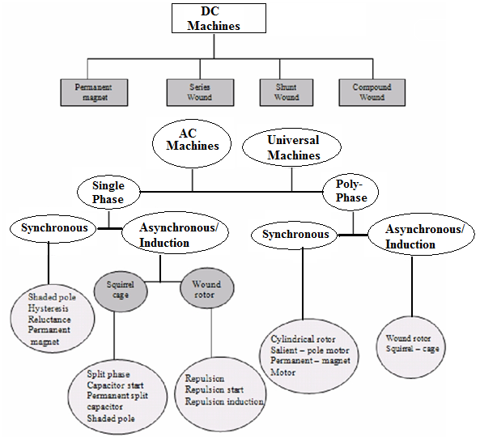
UNIT 2: Electric Motor
Classified by:
Electric power supply

Slide 21
UNIT 2: Electric Motor
Power Ratings-view point of temp
    Continuous: Continuous output supply without exceeding specific temperature rise above the ambient (40º). All parts attain a steady temperature. For fans, centrifugal pumps, lathes, conveyors etc.
    Short-time: Output supply for specific period (5, 15, 20, 30 or 60 minutes) without exceeding permissible temperature limit. Starts from cold and rest period is long enough for the machine to cool to ambient temperature. They are used for opening and closing weirs, lock-gates and bridges etc.
    Intermittent: Continuous output supply without exceeding specified temperature for a train of identical duty cycles consisting of loading and rest periods. Rise and fall in temperature for each duty cycle are equal. Suitable for hoisting mechanisms, trams, trolley-buses etc.

Slide 22
UNIT 2: Characteristic Curve of Technical System
Definition:
Characteristic curve shows the operating behaviour of technical system in the form of a graph of its variables
For every prime mover, there is a specific Torque/Speed curve and Power /speed curve

Slide 23
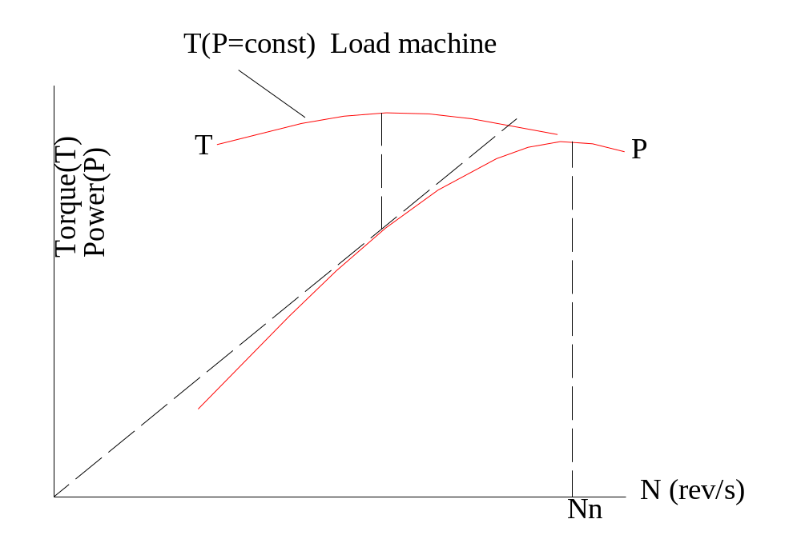
UNIT 2: Characteristic Curve of IC-Engine
Indicated mean pressure depends on effective re-charging cylinder.
At lower speeds:
Re-charging efficiency increases due to increasing negative suction pressure.
At high speeds:
losses due to whirl at the inlet and outlet canals
Re-charging efficiency drops
Mechanical losses increase with high speeds.

Slide 24
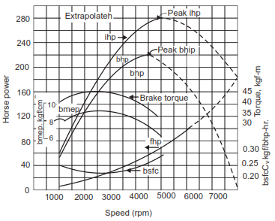
Characteristic Curve of IC-Engine
ihp: indicated horse power
bhp: brake horse power
fhp: friction horse power
bmep: brake mean effective pressure
bsfc: brake specific fuel consumption

Slide 25
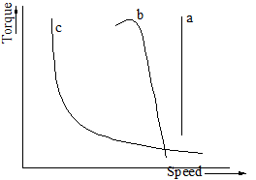
UNIT 2: Characteristic Curve of E-motors
Flat-type: Electromagnetic torque is independent of operating speed (Synchronous motors).
Shunt-type: Speed drops from no-load to full-load by a little percentage (AC-induction and DC-shunt motors).
Series-type : High electromagnetic torque at low speeds and vice-versa (AC-series, universal motors in small size and DC-series)

Slide 26
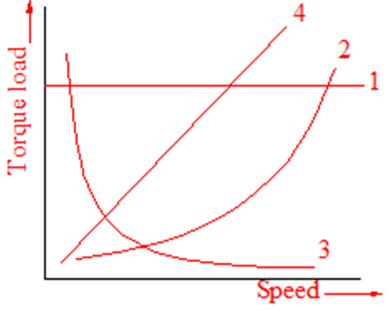
UNIT 2: Characteristic Curve of Loads
    Speed-torque characteristics independent of speed:
    Examples are cranes during hoisting, and loads in which friction is dominant like reciprocating pumps, air compressors etc
    Parabolic speed-torque characteristics:
    Examples are fans, centrifugal pumps, propellers in ships etc.
    Hyperbolic speed-torque characteristics:
    lathes, milling machines, machine tools, winches etc
    Linear speed-torque characteristics:
calendering machines, eddy-current brakes and generators feeding fixed resistors

Slide 27
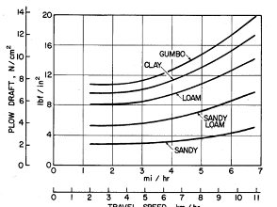
UNIT 2: Characteristic Curve of Ploughs in Various Soils

Slide 28
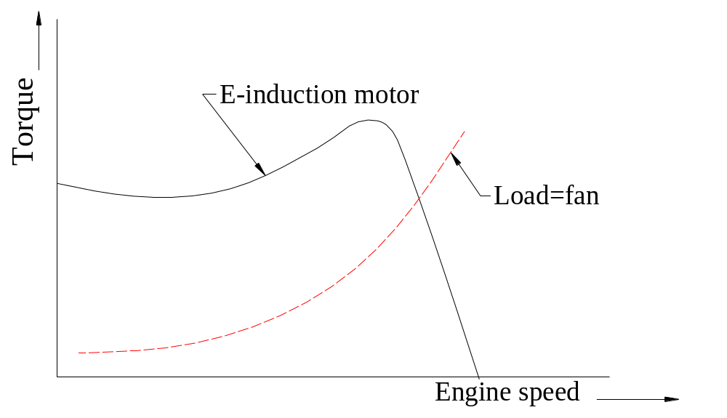
UNIT 2: Prime Mover – Load Matching
characteristics of prime mover and load must be known to a fair degree,
Both characteristics must be compatible

Slide 29
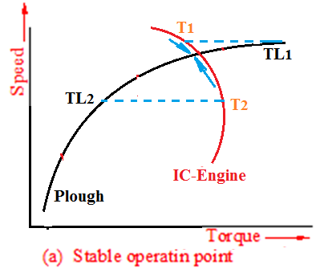
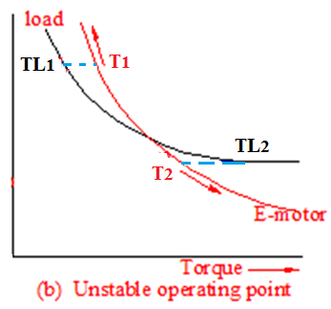
UNIT 2: Static Stability of Prime Mover - Load
Curves: Parabolic load (plough) and IC-Engine
Increase in resistance to plough leads to increase in torque of load. But with
Lower torque of prime mover leads to decrease in speed of the two units to operating point.
Curves: Hyperbolic load and AC-series E-motor
Decrease in torque of load is accompanied with increase in speed. But with
Higher torque of prime mover leads to further increase in speed of the two units and therefore move further from operating point.

Slide 30
UNIT 2: Asynchronous Motor Application
Petroleum and chemical pumps
Cooling towers
Air-handling equipment
Compressors
Process machinery
Blowers and fans Drilling machines
Grinders
Lathes
Conveyors
Crushers, etc

Slide 31

Thank You
For any concerns, please contact
elearning@knust.edu.gh
elearningknust@gmail.com
0322 191132

